Slide 1
Entity Attestation Token (EAT) Laurence Lundblade July 2018

Slide 2

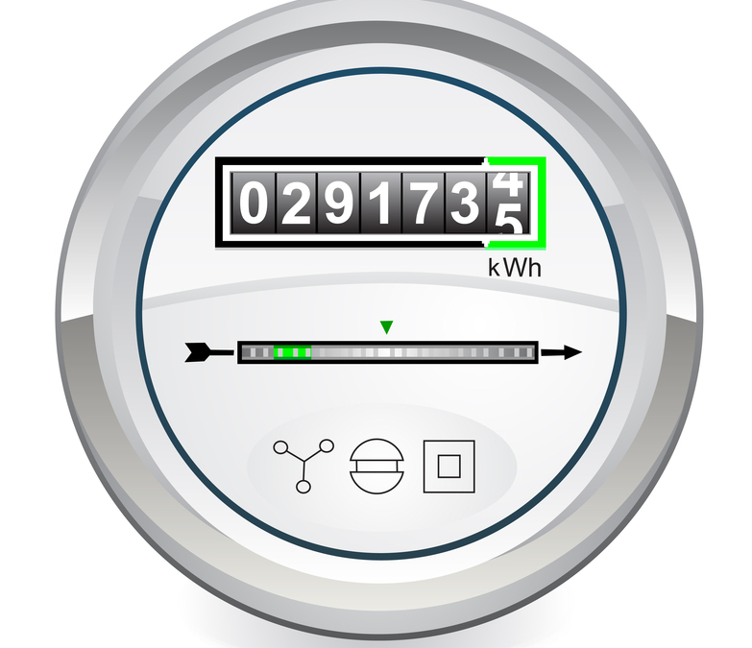

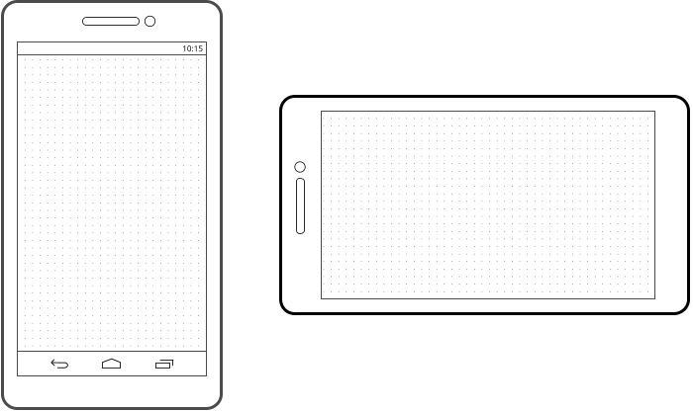
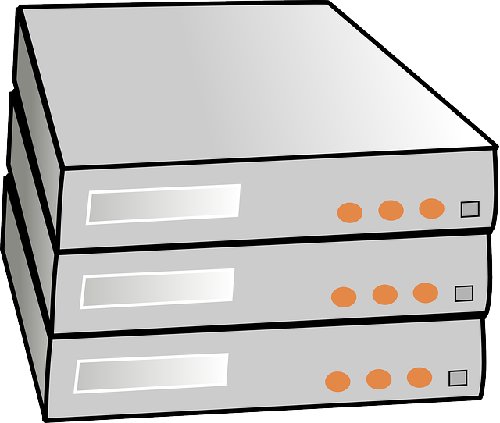
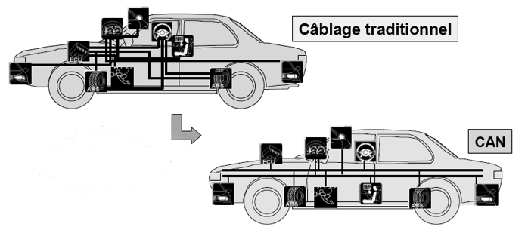
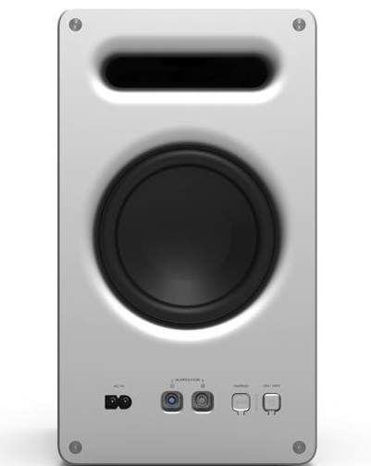
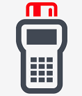



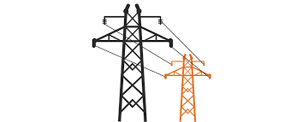
Entity
Attestation
Token
Good Devices
Chip & device manufacturer
Device ID (e.g. serial number)
Boot state, debug state…
Firmware, OS & app names and versions
Geographic location
Measurement,rooting & malware detection…
All Are Optional
Banking risk engine
IoT backend
Network infrastructure
Car components
Emulating
Real Device
Tampered
Bad Devices
Rooted
Cryptographically secured by signing
Cloned
Enterprise auth risk engine
Electric company

Slide 3
End-End Attestation Flow
Entity Manufacturer
(e.g. chip or device vendor)
Provision private keys during manufacturing
Entity (e.g., Chip, Device…)
Verification Keys
Private key for signing. Stored securely on device
Self-secured token carried in protocol messages
Claims data
Relying Party (e.g., Server / Service)
Token Creation and Signing
Verification Process
Processing such as a payment or authentication risk engine
EAT Token
Verified claims
Other flows are possible where verification is done by a service or by the entity vendor.

Slide 4
EAT Format
COSE format for signing
Small message size for IoT
Allows for varying signing algorithms, carries headers, sets overall format
Overall structure: COSE_Sign1
Algorithm -- Examples: ECDSA 256, RSA 2048, ECDAA
Signing Scheme -- Examples: IEEE IDevID, EPID, X.509 Hierarchy
protected
headers
CBOR format for claims
Small message size for IoT
Labelling of claims
Very flexible data types for all kinds of different claims.
Translates to JSON
Key ID -- identifies the key needed to verify signature
Certs (optional) -- to chain up to a root for some signing schemes
unprotected
headers
CBOR formatted map of claims that describe device and its disposition
Few and simple or many, complex, nested…
All claims are optional -- no minimal set
The format and meaning of a basic set of claims should be standardized for interoperability
Should be adaptable to cover many different use cases from tiny IoT devices to complex mobile phones
Privacy issues must be taken into account
Signature proves device and claims (critical)
Accommodate different end-end signing schemes because of device manufacturing issues
Privacy requirements also drive variance in signing schemes
Signed payload
sig
signature -- Examples: 64 byte ECDSA signature, 256 byte RSA signature

Slide 5
Similar and Related Technologies
Technology | Use Case
FIDO Attestation | Attestation of FIDO Authenticator implementations
Android Key Store | Attestation key pairs in the key store
NEA | Collect and send endpoint security posture (e.g. anti-virus SW state and config) to enterprise collection / monitoring point
RATS / NSF | Attestation / Measurement of SW on Network Security Functions (e.g., firewalls)
TPM | Attestation / Measurement of SW running on a device
BRSKI / Zero Touch | Authenticates IoT devices for enrollment in IoT management system

Slide 6
More Info
Non-WG mailing list: eat@ietf.org
Mail list info: https://www.ietf.org/mailman/listinfo/EAT
Draft document: https://tools.ietf.org/html/draft-mandyam-eat-00
Github: https://github.com/eat-ietf-wg

